Slide 1

ROBINHOOD
Hypyxel

Slide 2






TEAM INTRODUCTION
Ritica
Sridhar
Rutuja Patole
Rishab
Raj
Ashwin Kumar Sangareddypeta
Raksha Rajasimha

Slide 3
Overview of RobinHood
No traditional brokerage fees.
User-friendly interface and mobile app design
Introduced commission-free trading.
Introduction of fractional shares

Slide 4

OUR PROBLEM
Lack of Practice Ground for Beginners.
Need for Educational Simulators or Virtual Trading Tools.

Slide 5
Problem Statement
New investors using Robinhood face a challenge: they lack a safe way to practice trading without risking real money. Without tools like virtual practice accounts, beginners find it hard to develop and test their investing strategies before entering the actual market

Slide 6
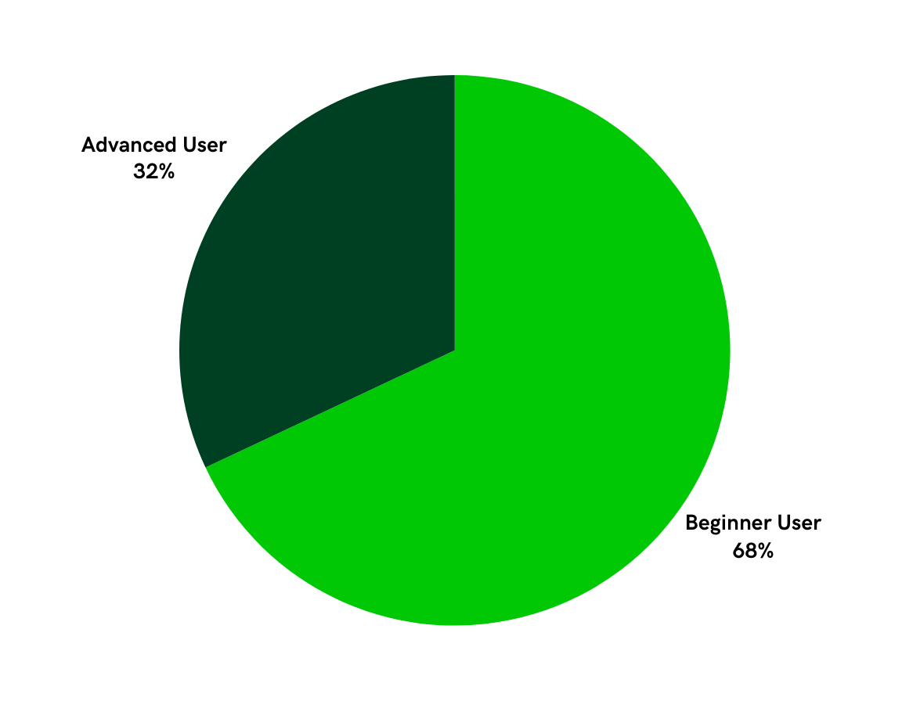
Customer Survey Responses
Diverse customer base

Slide 7
Feature Preferences
For the Beginner and the Advanced

Slide 8
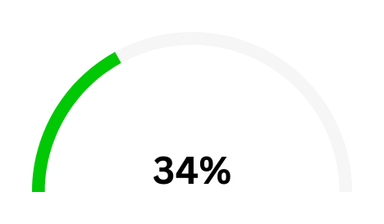
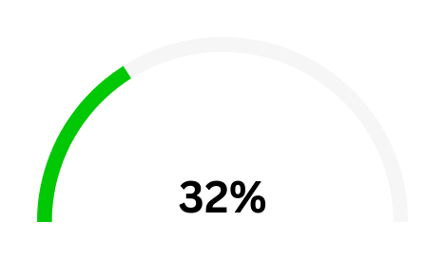
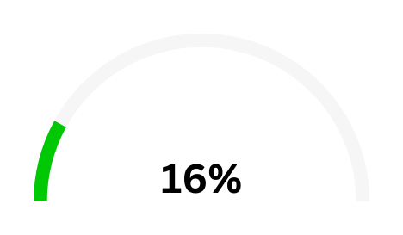
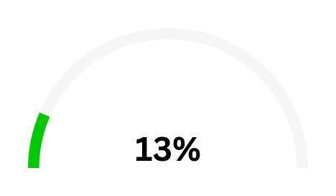
Beginner Users
Virtual Trading Platform
Educational Videos
Easy-to-Use Interface
Community Forum
Survey results of what new features a Beginner user wants from the app.

Slide 9
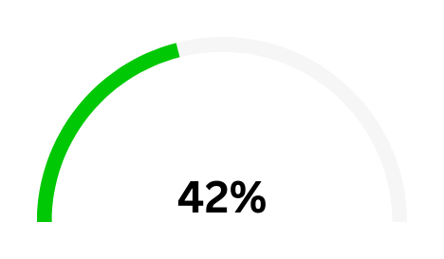
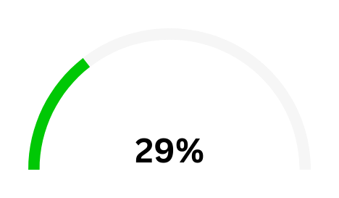

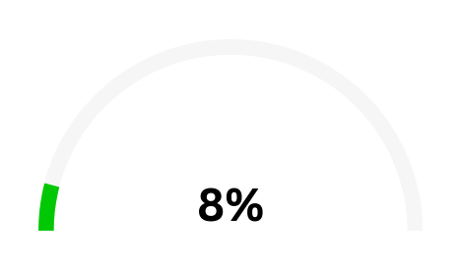
Advanced Users
Customizable Dashboard
Techincal and Custom Indicator
Community Forum
Advance Analytical Tools
Survey results of what new features an Advanced user wants from the app.

Slide 10
Existing & Target Customers
Customer base and beyond

Slide 11
Existing Customer
Demographics:
Mainly Millennials and Gen Z.
Investment Experience:
Relatively new to investing.
Investment Behavior:
Leans towards shorter-term investments.

Slide 12
Target Customer
Experienced Traders and Long-term Investors.
Attraction through Advanced Features:
Complex trading options, more in-depth analytical tools, and enhanced market data
Strategic Goals:
Retain the user base for a longer term.

Slide 13


USER PERSONAS

Slide 14
User Persona:
Alexa: The Beginner Trader
Name: Alexa Stockman
Age: 28
Occupation: Urban Professional
Trading Experience: Beginner
Goals: Learning the basics of trading, risk-free practice.
Key Needs: Clear, educational content and a safe environment to learn trading.

Slide 15
User Persona:
Jordan: The Advanced Investor
Name: Jordan Banks
Age: 40
Occupation: Experienced Investor
Trading Experience: Advanced
Goals: In-depth market analysis, portfolio customization.
Key Needs: Focus on advanced, customizable tools and detailed analytics.

Slide 16

COMPANY’S MISSION AND VISION

Slide 17
MISSION
To democratize finance for all.
VISION
To become the most personal and inclusive investing platform in the world.

Slide 18


CORE VALUES
Simplicity
Accessibilty
Innovation
Integrity
Impact
Financial inclusion
Transparency

Slide 19
OUR MISSION AND VISION

Slide 20
VISION
MISSION
Foster a community of confident and informed investors, breaking down barriers to financial literacy and enabling universal participation in the world of investing.
Empower new investors on Robinhood by providing a safe space for learning and practicing trading strategies through virtual accounts.

Slide 21
POSITIONING STATEMENT
Robinhood is the pioneer of commission-free investing, empowering individuals to take control of their financial future. With a user-friendly platform and a commitment to democratizing finance, we provide easy access to the financial markets, inspiring a new generation of investors to build wealth on their terms

Slide 22
OUR SOLUTION
Educational Resources
Virtual Practice Accounts
Providing tutorials, guides, and interactive modules that help new investors understand the basics of the app..
Implement a simulated or virtual trading feature within the Robinhood platform.
Simulated Trading Analytics
Customizable Dashboards
Provide detailed insights into simulated trades such as performance metrics, risk analysis, and strategy effectiveness
Create a customizable dashboard for users to monitor and analyze their virtual trading performance.

Slide 23
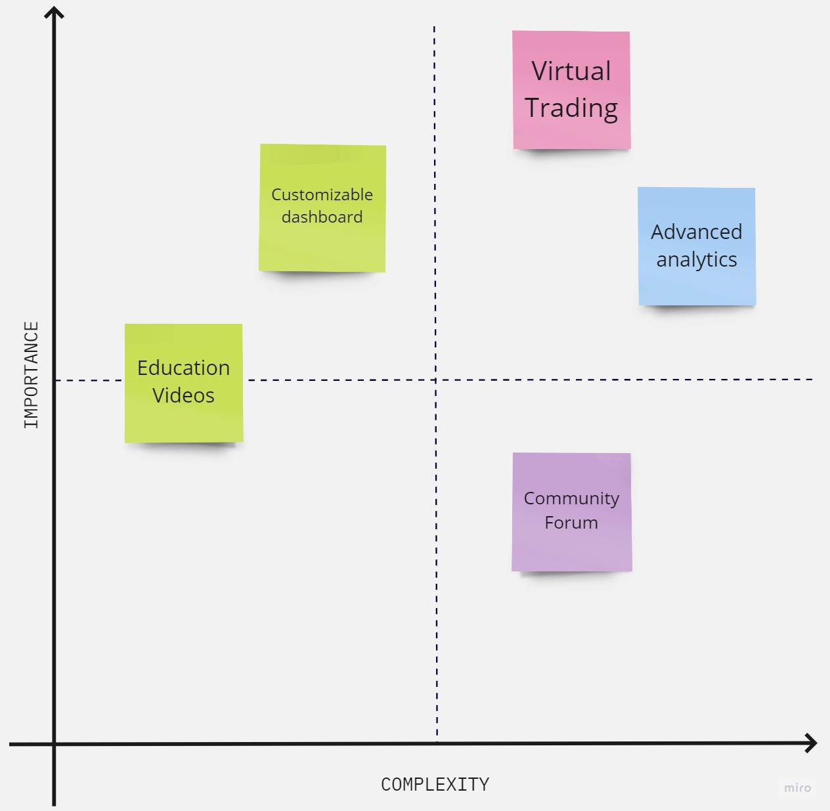
Feature Prioritization Matrix

Slide 24


















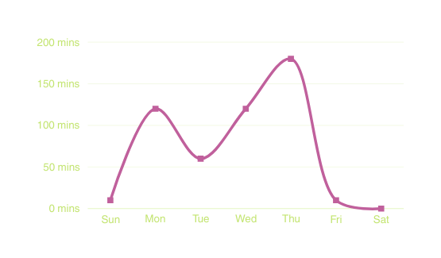






9:41
9:41
Hello, John!
Stock Trading for Newbies
What do you wanna learn today?
In Progress
Stock Trading for Newbies
The Art of Trading: Strategies for Success
75%
25%
4.6
517 ratings
4.6
517 ratings
Lectures
Notes
Reviews
Free
Free
E-LEARNING
Recommended
Introduction
Guide to invest good
A Captivating Guide to Masterful Investing
Video - 04:12 mins
4.6
517 ratings
4.6
517 ratings
2. Discover resources
Free
Free
Video - 04:15 mins
Time spent learning
29 Oct - 4 Nov
3. Understanding the Stock Market
Video - 05:00 mins
4. Introduction to Stock Exchanges
Video - 15:49 mins

Slide 25










9:41
9:41
Communities
Forum
Trending Now
Sort / Filter
Stocks
Tips
Bitcoin
ETF
Finance
📈
💡
₿
Ashley
1h
Lessons Learned from a Recent Trade - Share Your Experiences!
Community Spotlights
Skyrocketing to Success
read 89 replies
45 impressions
Upvote
Reply
Tesla (TSLA) has been on a meteoric rise, leaving traders in awe of its impressive gains. Dive into the charts, analyze the catalysts, and share your thoughts on how Tesla (TSLA) became the star of the trading floor.
John
1h
COMMUNITY AND FORUMS
Upcoming IPOs and ICOs - What's on Your Radar?
Author: @crabby78
Upvote
Reply
more
read 89 replies
3 impressions
Top members
Foxey
1h
Ashley
John
Favorite Trading Strategies – Let’s Discuss!
1k followers
78 followers
45 impressions
45 impressions
read 89 replies
40 impressions
Upvote
Reply
Ralph
Foxey
1k followers
1k followers
Ralph
1h
45 impressions
45 impressions
more
I've heard a lot about NFTs. Can someone explain how they work and how to invest in them?
What do you have in mind?
What do you have in mind?
Post
Post

Slide 26
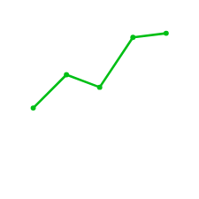

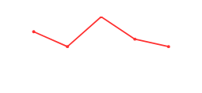
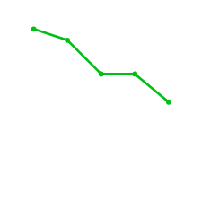
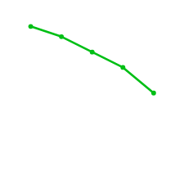

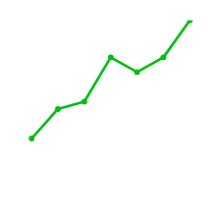
9:41
Paper Trading
Portfolio
Invested
Total earnings
VIRTUAL TRADING
$500.38
$10500
Available
Holdings
$4500.69
5
Holdings
NVDA
$482.08
Add a subheading
107 shares
Intuitive Dashboard
Virtual portfolio tracking with accurate and real-time positions
Access to advanced analytics
Performance Analytics
AMC
$6.78
1007 shares
WMT
$158.09
545 shares
See All
Lists
+
Add to watchlist or screener
LCID
$56.78
Lucid Group
RIVN
$16.63
Rivian Automotive

Slide 27

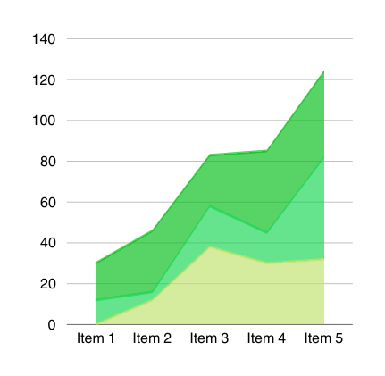

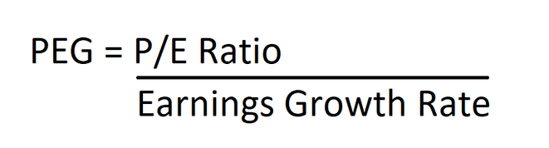
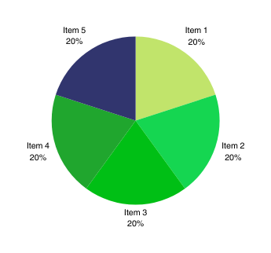
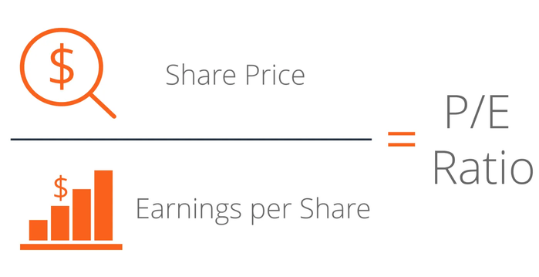


9:41
CUSTOMIZABLE DASHBOARD
Dashboard
Earnings
29 Oct - 4 Nov
Available
Invested
$1500
$1800
$1308
$1500
Tesla launches new CyberTruck
$1260
$600
Tesla (TSLA) has been on a meteoric rise, leaving traders in awe of its impressive gains. Dive into the charts, Cybertruck coming to Earth on November 30th. Prepare for blastoff at 2 PM CT.
$0
$0
Market Sentiment
Sun
Mon
Tue
Wed
Thu
Fri
Sat
Bullish / Neutral / Bearish
Stocks
ETF
Crypto
Options
9 %
Custom Graphs
ETF
Formula tabs
0 %
91 %
Options
Stocks
0 %
Crypto
Your Widgets
+
+
+

Slide 28
PRODUCT ROADMAP

Slide 29







Customer Trial Focus
Advance Focus
Virtual Trading Platform
Hands on trading platform for beginners
Adding Technical and Customizable indicators, interactive graphs.
Educational Focus
Community Focus
Dashboard
Educate customers on Platform via videos
Spread Platform Features Awareness
Creation of community forum
Interact with fellow traders
Customizable Dashboard Creation
Mainly for advance traders
Dec 2023
Jun 2024
Dec 2024
Mar 2024
Sep 2024
Planning video content and scripting
Working with the designers on visual design using Adobe Premiere Pro
Integration of videos on the platform
Setting up platform & configuring it
Developing clear guidelines,rules and policies
Regularly maintaining the forum
Creating the layout of the dashboard
Working with the development team for implementation of the dashboard
Testing and monitoring the dashboard
Designing virtual trading platform architecture using Visual Studio Code & Adobe XD
Conducting platform testing
Setting up the databases like MySQL
Implement a data pipeline to fetch and process information seamlessly
Integrating analytical tool with Robinhood Platform
Prioritize data security and compliance with privacy regulations

Slide 30
COMPETITORS

Slide 31




User-Friendly UI
Limited Features
Feature Intensive
Not So User-Friendly UI

Slide 32


